Slide 1

Campus Access
Team 2
Drew Whiteside, Lauren Jablunovsky, Daniel Mezhinsky, Tyler Marzen, Ishaan Bansal

Slide 2

Background Summary
3.6 million Americans wheelchair-bound (1%)
Equates to about 350 wheelchair users on Pitt’s campus
14 million Americans visually impaired (4%)
Equates to about 1,280 people on campus
1 wheelchair user in 91 students
1 visually impared person in 25 students
[1] Admin. “U.S. Wheelchair User Statistics.” Pants Up Easy, 29 July 2017, https://www.pantsupeasy.com/u-s-wheelchair-user-statistics/
[2] “Study Finds Most Americans Have Good Vision, but 14 Million Are Visually Impaired.” National Institutes of Health, U.S. Department of Health and Human Services, 9 Dec. 2015, https://www.nih.gov/news-events/news-releases/study-finds-most-americans-have-good-vision-14-million-are-visually-impaired
Notes:
Decided to switch focus to wheelchair/blind only

Slide 3
Background Summary (cont’d)
Accessibility issues in Pitt campus buildings
Information Science Building on N Bellefield Ave
Bathrooms in narrow staircases
No way of knowing these access issues beforehand
Notes:
Also mentioning Holland Hall
Someone who is not aware of this could try to use a bathroom and risk falling down stairs

Slide 4




Problem Statement
No comprehensive guide is available to help navigate buildings
Campus disability resources are not always built with accessibility in mind
Lack of community among people with disabilities on campus

Slide 5

Our Solution
Create a hybrid interface for wheelchair-bound and blind users to help navigate campus using a Google Maps interface
List where accessible restrooms, entrances, and elevators are located for each building
Commenting capability for users to share their accessibility experience in certain buildings

Slide 6

Constraints
Mobile phone or computer with Internet access
Text-to-speech settings enabled
Operating system updated to latest version
Our dependencies:
Pitt servers for authentication
Google Maps
Pitt Police

Slide 7
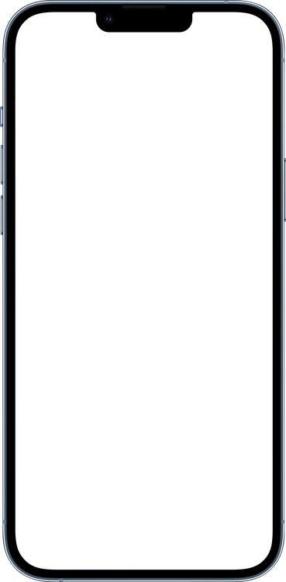

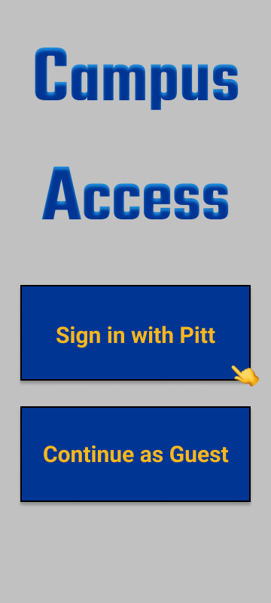
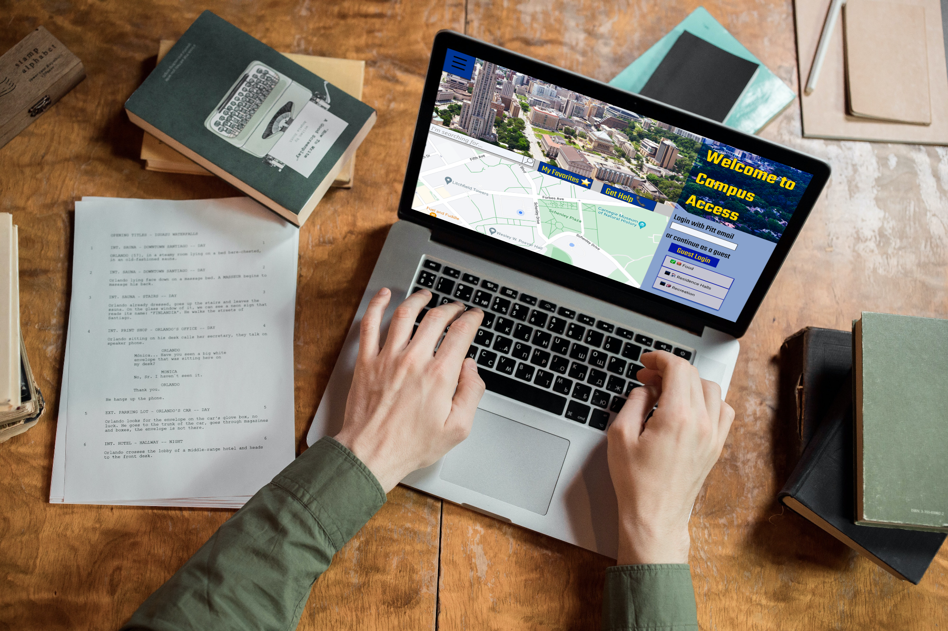
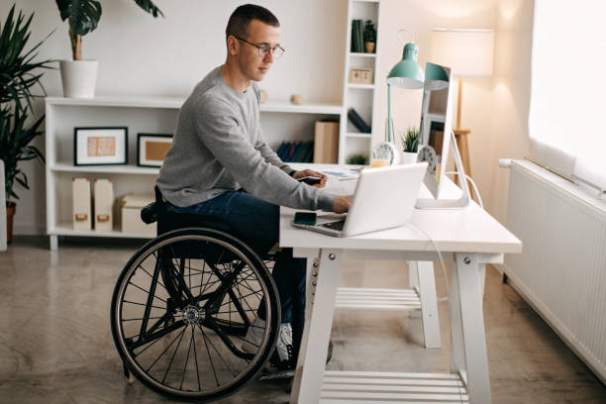
App Features (Use Case)
Notes:
Jimmy (wheelchair-bound)
Going from Litchfield Towers to his class in the Information Science Building
Visits campus access website, views general directions + where the accessible restrooms, ramps, and elevators are located
Begins his trip, enters IS building as destination, and follows path on the app
Sees ramp and elevators exactly as he saw on the website
On his way back, he sees the intersection that he is trying to cross is not functioning and needs a Pitt Angel to help him cross the street safely
Jimmy is a user who is wheelchair-bound. He has a class in the Information Science (IS) Building and lives in the Litchfield Towers. Jimmy wants to find the most accessible way to get from the towers to the IS building. He goes onto the campus access website and plans his trip first. He finds the most accessible directions to get to the IS building and finds out where the accessible restrooms, ramps, and elevators are located. Then he begins his trip and accesses the app to help find his destination. Once he gets to his destination and finds the ramp, he is able to once again see where the restrooms are located and sees that the elevators are there as soon as he rolls into the building.
Use case 2: Mary is a user who is blind. She is right outside of Sutherland Hall and does not know how to get back to her dorm at Bruce Hall. She uses the Voiceover feature on her iPhone She decides to call for a Pitt Angel for help and it announces that the Pitt Angel is about 5 minutes away. Once Bruce, the Pitt Angel shows up, he helps guide her back to Bruce Hall.
2 - Mary (blind)
Going from Sutherland Hall to her dorm at Bruce Hall
Uses the Voiceover feature on her iPhone to call for a Pitt Angel for help
Receives notice that Pitt Angel is about 5 minutes away.
Pitt Angel shows up, who helps guide her back to Bruce Hall.

Slide 8
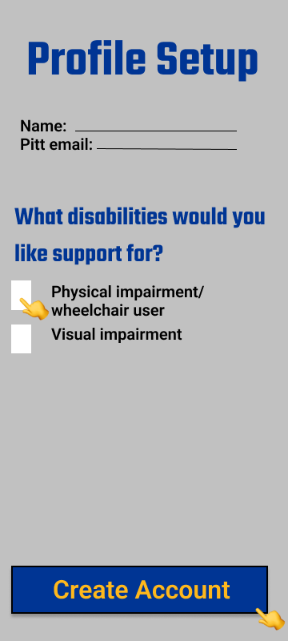
App Features (Use Case)
Notes:
Jimmy (wheelchair-bound)
Going from Litchfield Towers to his class in the Information Science Building
Visits campus access website, views general directions + where the accessible restrooms, ramps, and elevators are located
Begins his trip, enters IS building as destination, and follows path on the app
Sees ramp and elevators exactly as he saw on the website
On his way back, he sees the intersection that he is trying to cross is not functioning and needs a Pitt Angel to help him cross the street safely
Jimmy is a user who is wheelchair-bound. He has a class in the Information Science (IS) Building and lives in the Litchfield Towers. Jimmy wants to find the most accessible way to get from the towers to the IS building. He goes onto the campus access website and plans his trip first. He finds the most accessible directions to get to the IS building and finds out where the accessible restrooms, ramps, and elevators are located. Then he begins his trip and accesses the app to help find his destination. Once he gets to his destination and finds the ramp, he is able to once again see where the restrooms are located and sees that the elevators are there as soon as he rolls into the building.
Use case 2: Mary is a user who is blind. She is right outside of Sutherland Hall and does not know how to get back to her dorm at Bruce Hall. She uses the Voiceover feature on her iPhone She decides to call for a Pitt Angel for help and it announces that the Pitt Angel is about 5 minutes away. Once Bruce, the Pitt Angel shows up, he helps guide her back to Bruce Hall.
2 - Mary (blind)
Going from Sutherland Hall to her dorm at Bruce Hall
Uses the Voiceover feature on her iPhone to call for a Pitt Angel for help
Receives notice that Pitt Angel is about 5 minutes away.
Pitt Angel shows up, who helps guide her back to Bruce Hall.

Slide 9
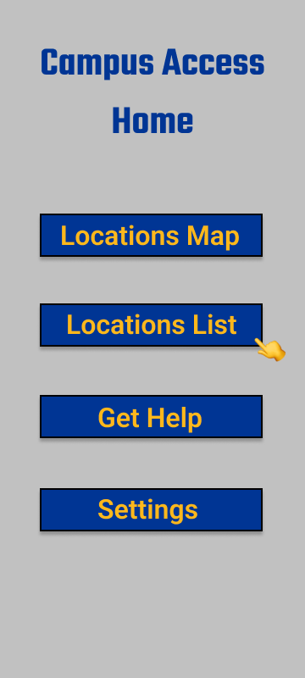
App Features (Use Case)
Notes:
Jimmy (wheelchair-bound)
Going from Litchfield Towers to his class in the Information Science Building
Visits campus access website, views general directions + where the accessible restrooms, ramps, and elevators are located
Begins his trip, enters IS building as destination, and follows path on the app
Sees ramp and elevators exactly as he saw on the website
On his way back, he sees the intersection that he is trying to cross is not functioning and needs a Pitt Angel to help him cross the street safely
Jimmy is a user who is wheelchair-bound. He has a class in the Information Science (IS) Building and lives in the Litchfield Towers. Jimmy wants to find the most accessible way to get from the towers to the IS building. He goes onto the campus access website and plans his trip first. He finds the most accessible directions to get to the IS building and finds out where the accessible restrooms, ramps, and elevators are located. Then he begins his trip and accesses the app to help find his destination. Once he gets to his destination and finds the ramp, he is able to once again see where the restrooms are located and sees that the elevators are there as soon as he rolls into the building.
Use case 2: Mary is a user who is blind. She is right outside of Sutherland Hall and does not know how to get back to her dorm at Bruce Hall. She uses the Voiceover feature on her iPhone She decides to call for a Pitt Angel for help and it announces that the Pitt Angel is about 5 minutes away. Once Bruce, the Pitt Angel shows up, he helps guide her back to Bruce Hall.
2 - Mary (blind)
Going from Sutherland Hall to her dorm at Bruce Hall
Uses the Voiceover feature on her iPhone to call for a Pitt Angel for help
Receives notice that Pitt Angel is about 5 minutes away.
Pitt Angel shows up, who helps guide her back to Bruce Hall.

Slide 10
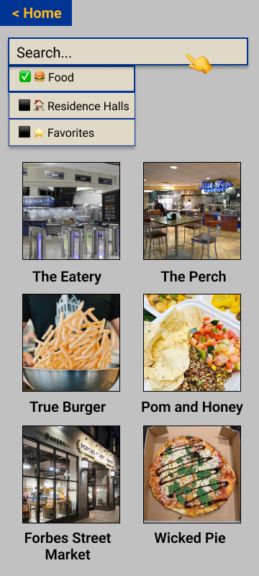
App Features (Use Case)
Notes:
Jimmy (wheelchair-bound)
Going from Litchfield Towers to his class in the Information Science Building
Visits campus access website, views general directions + where the accessible restrooms, ramps, and elevators are located
Begins his trip, enters IS building as destination, and follows path on the app
Sees ramp and elevators exactly as he saw on the website
On his way back, he sees the intersection that he is trying to cross is not functioning and needs a Pitt Angel to help him cross the street safely
Jimmy is a user who is wheelchair-bound. He has a class in the Information Science (IS) Building and lives in the Litchfield Towers. Jimmy wants to find the most accessible way to get from the towers to the IS building. He goes onto the campus access website and plans his trip first. He finds the most accessible directions to get to the IS building and finds out where the accessible restrooms, ramps, and elevators are located. Then he begins his trip and accesses the app to help find his destination. Once he gets to his destination and finds the ramp, he is able to once again see where the restrooms are located and sees that the elevators are there as soon as he rolls into the building.
Use case 2: Mary is a user who is blind. She is right outside of Sutherland Hall and does not know how to get back to her dorm at Bruce Hall. She uses the Voiceover feature on her iPhone She decides to call for a Pitt Angel for help and it announces that the Pitt Angel is about 5 minutes away. Once Bruce, the Pitt Angel shows up, he helps guide her back to Bruce Hall.
2 - Mary (blind)
Going from Sutherland Hall to her dorm at Bruce Hall
Uses the Voiceover feature on her iPhone to call for a Pitt Angel for help
Receives notice that Pitt Angel is about 5 minutes away.
Pitt Angel shows up, who helps guide her back to Bruce Hall.

Slide 11
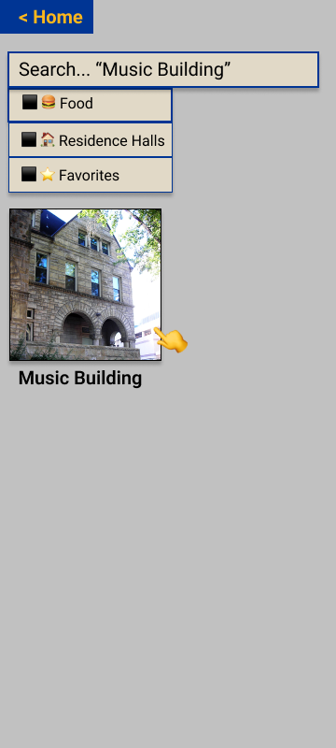
App Features (Use Case)
Notes:
Jimmy (wheelchair-bound)
Going from Litchfield Towers to his class in the Information Science Building
Visits campus access website, views general directions + where the accessible restrooms, ramps, and elevators are located
Begins his trip, enters IS building as destination, and follows path on the app
Sees ramp and elevators exactly as he saw on the website
On his way back, he sees the intersection that he is trying to cross is not functioning and needs a Pitt Angel to help him cross the street safely
Jimmy is a user who is wheelchair-bound. He has a class in the Information Science (IS) Building and lives in the Litchfield Towers. Jimmy wants to find the most accessible way to get from the towers to the IS building. He goes onto the campus access website and plans his trip first. He finds the most accessible directions to get to the IS building and finds out where the accessible restrooms, ramps, and elevators are located. Then he begins his trip and accesses the app to help find his destination. Once he gets to his destination and finds the ramp, he is able to once again see where the restrooms are located and sees that the elevators are there as soon as he rolls into the building.
Use case 2: Mary is a user who is blind. She is right outside of Sutherland Hall and does not know how to get back to her dorm at Bruce Hall. She uses the Voiceover feature on her iPhone She decides to call for a Pitt Angel for help and it announces that the Pitt Angel is about 5 minutes away. Once Bruce, the Pitt Angel shows up, he helps guide her back to Bruce Hall.
2 - Mary (blind)
Going from Sutherland Hall to her dorm at Bruce Hall
Uses the Voiceover feature on her iPhone to call for a Pitt Angel for help
Receives notice that Pitt Angel is about 5 minutes away.
Pitt Angel shows up, who helps guide her back to Bruce Hall.

Slide 12
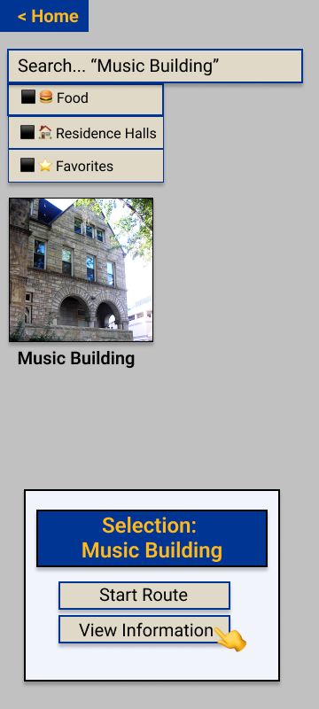
App Features (Use Case)
Notes:
Jimmy (wheelchair-bound)
Going from Litchfield Towers to his class in the Information Science Building
Visits campus access website, views general directions + where the accessible restrooms, ramps, and elevators are located
Begins his trip, enters IS building as destination, and follows path on the app
Sees ramp and elevators exactly as he saw on the website
On his way back, he sees the intersection that he is trying to cross is not functioning and needs a Pitt Angel to help him cross the street safely
Jimmy is a user who is wheelchair-bound. He has a class in the Information Science (IS) Building and lives in the Litchfield Towers. Jimmy wants to find the most accessible way to get from the towers to the IS building. He goes onto the campus access website and plans his trip first. He finds the most accessible directions to get to the IS building and finds out where the accessible restrooms, ramps, and elevators are located. Then he begins his trip and accesses the app to help find his destination. Once he gets to his destination and finds the ramp, he is able to once again see where the restrooms are located and sees that the elevators are there as soon as he rolls into the building.
Use case 2: Mary is a user who is blind. She is right outside of Sutherland Hall and does not know how to get back to her dorm at Bruce Hall. She uses the Voiceover feature on her iPhone She decides to call for a Pitt Angel for help and it announces that the Pitt Angel is about 5 minutes away. Once Bruce, the Pitt Angel shows up, he helps guide her back to Bruce Hall.
2 - Mary (blind)
Going from Sutherland Hall to her dorm at Bruce Hall
Uses the Voiceover feature on her iPhone to call for a Pitt Angel for help
Receives notice that Pitt Angel is about 5 minutes away.
Pitt Angel shows up, who helps guide her back to Bruce Hall.

Slide 13
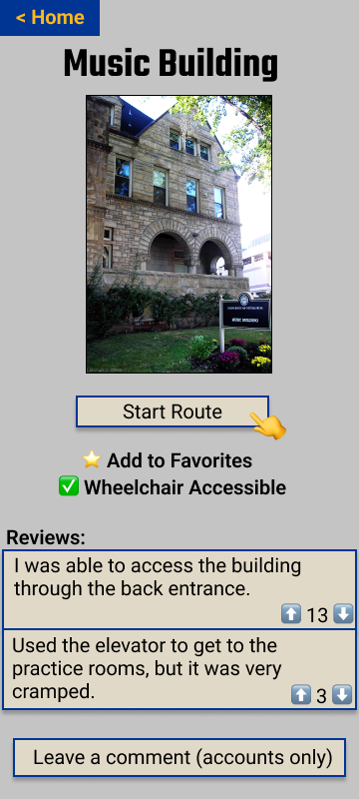
App Features (Use Case)
Notes:
Jimmy (wheelchair-bound)
Going from Litchfield Towers to his class in the Information Science Building
Visits campus access website, views general directions + where the accessible restrooms, ramps, and elevators are located
Begins his trip, enters IS building as destination, and follows path on the app
Sees ramp and elevators exactly as he saw on the website
On his way back, he sees the intersection that he is trying to cross is not functioning and needs a Pitt Angel to help him cross the street safely
Jimmy is a user who is wheelchair-bound. He has a class in the Information Science (IS) Building and lives in the Litchfield Towers. Jimmy wants to find the most accessible way to get from the towers to the IS building. He goes onto the campus access website and plans his trip first. He finds the most accessible directions to get to the IS building and finds out where the accessible restrooms, ramps, and elevators are located. Then he begins his trip and accesses the app to help find his destination. Once he gets to his destination and finds the ramp, he is able to once again see where the restrooms are located and sees that the elevators are there as soon as he rolls into the building.
Use case 2: Mary is a user who is blind. She is right outside of Sutherland Hall and does not know how to get back to her dorm at Bruce Hall. She uses the Voiceover feature on her iPhone She decides to call for a Pitt Angel for help and it announces that the Pitt Angel is about 5 minutes away. Once Bruce, the Pitt Angel shows up, he helps guide her back to Bruce Hall.
2 - Mary (blind)
Going from Sutherland Hall to her dorm at Bruce Hall
Uses the Voiceover feature on her iPhone to call for a Pitt Angel for help
Receives notice that Pitt Angel is about 5 minutes away.
Pitt Angel shows up, who helps guide her back to Bruce Hall.

Slide 14
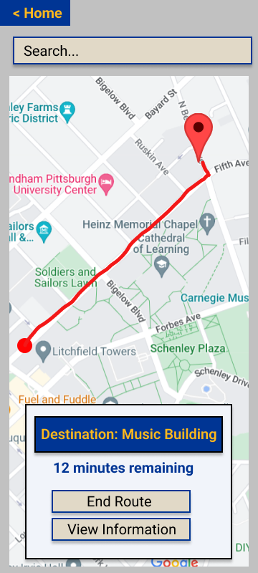
App Features (Use Case)
Notes:
Jimmy (wheelchair-bound)
Going from Litchfield Towers to his class in the Information Science Building
Visits campus access website, views general directions + where the accessible restrooms, ramps, and elevators are located
Begins his trip, enters IS building as destination, and follows path on the app
Sees ramp and elevators exactly as he saw on the website
On his way back, he sees the intersection that he is trying to cross is not functioning and needs a Pitt Angel to help him cross the street safely
Jimmy is a user who is wheelchair-bound. He has a class in the Information Science (IS) Building and lives in the Litchfield Towers. Jimmy wants to find the most accessible way to get from the towers to the IS building. He goes onto the campus access website and plans his trip first. He finds the most accessible directions to get to the IS building and finds out where the accessible restrooms, ramps, and elevators are located. Then he begins his trip and accesses the app to help find his destination. Once he gets to his destination and finds the ramp, he is able to once again see where the restrooms are located and sees that the elevators are there as soon as he rolls into the building.
Use case 2: Mary is a user who is blind. She is right outside of Sutherland Hall and does not know how to get back to her dorm at Bruce Hall. She uses the Voiceover feature on her iPhone She decides to call for a Pitt Angel for help and it announces that the Pitt Angel is about 5 minutes away. Once Bruce, the Pitt Angel shows up, he helps guide her back to Bruce Hall.
2 - Mary (blind)
Going from Sutherland Hall to her dorm at Bruce Hall
Uses the Voiceover feature on her iPhone to call for a Pitt Angel for help
Receives notice that Pitt Angel is about 5 minutes away.
Pitt Angel shows up, who helps guide her back to Bruce Hall.

Slide 15
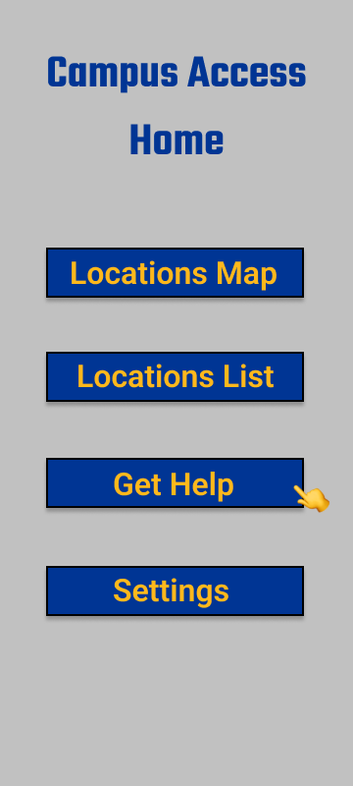
App Features (Use Case)
Notes:
Jimmy (wheelchair-bound)
Going from Litchfield Towers to his class in the Information Science Building
Visits campus access website, views general directions + where the accessible restrooms, ramps, and elevators are located
Begins his trip, enters IS building as destination, and follows path on the app
Sees ramp and elevators exactly as he saw on the website
On his way back, he sees the intersection that he is trying to cross is not functioning and needs a Pitt Angel to help him cross the street safely
Jimmy is a user who is wheelchair-bound. He has a class in the Information Science (IS) Building and lives in the Litchfield Towers. Jimmy wants to find the most accessible way to get from the towers to the IS building. He goes onto the campus access website and plans his trip first. He finds the most accessible directions to get to the IS building and finds out where the accessible restrooms, ramps, and elevators are located. Then he begins his trip and accesses the app to help find his destination. Once he gets to his destination and finds the ramp, he is able to once again see where the restrooms are located and sees that the elevators are there as soon as he rolls into the building.
Use case 2: Mary is a user who is blind. She is right outside of Sutherland Hall and does not know how to get back to her dorm at Bruce Hall. She uses the Voiceover feature on her iPhone She decides to call for a Pitt Angel for help and it announces that the Pitt Angel is about 5 minutes away. Once Bruce, the Pitt Angel shows up, he helps guide her back to Bruce Hall.
2 - Mary (blind)
Going from Sutherland Hall to her dorm at Bruce Hall
Uses the Voiceover feature on her iPhone to call for a Pitt Angel for help
Receives notice that Pitt Angel is about 5 minutes away.
Pitt Angel shows up, who helps guide her back to Bruce Hall.

Slide 16
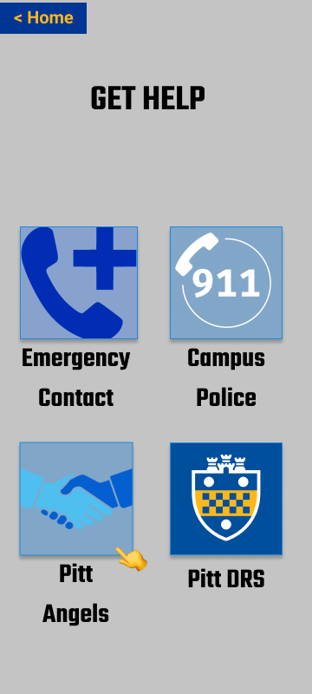
App Features (Use Case)
Notes:
Jimmy (wheelchair-bound)
Going from Litchfield Towers to his class in the Information Science Building
Visits campus access website, views general directions + where the accessible restrooms, ramps, and elevators are located
Begins his trip, enters IS building as destination, and follows path on the app
Sees ramp and elevators exactly as he saw on the website
On his way back, he sees the intersection that he is trying to cross is not functioning and needs a Pitt Angel to help him cross the street safely
Jimmy is a user who is wheelchair-bound. He has a class in the Information Science (IS) Building and lives in the Litchfield Towers. Jimmy wants to find the most accessible way to get from the towers to the IS building. He goes onto the campus access website and plans his trip first. He finds the most accessible directions to get to the IS building and finds out where the accessible restrooms, ramps, and elevators are located. Then he begins his trip and accesses the app to help find his destination. Once he gets to his destination and finds the ramp, he is able to once again see where the restrooms are located and sees that the elevators are there as soon as he rolls into the building.
Use case 2: Mary is a user who is blind. She is right outside of Sutherland Hall and does not know how to get back to her dorm at Bruce Hall. She uses the Voiceover feature on her iPhone She decides to call for a Pitt Angel for help and it announces that the Pitt Angel is about 5 minutes away. Once Bruce, the Pitt Angel shows up, he helps guide her back to Bruce Hall.
2 - Mary (blind)
Going from Sutherland Hall to her dorm at Bruce Hall
Uses the Voiceover feature on her iPhone to call for a Pitt Angel for help
Receives notice that Pitt Angel is about 5 minutes away.
Pitt Angel shows up, who helps guide her back to Bruce Hall.

Slide 17


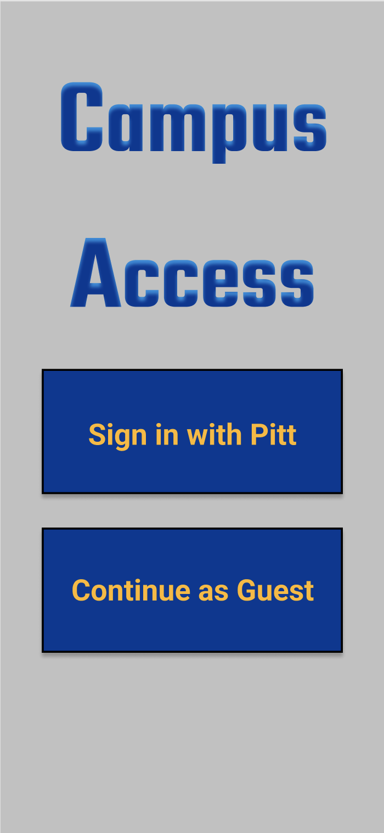











Tech / Backend
Server (Cloud Hosting)
Mobile App
Built with
Support for
Database
Web Interface
Built with
Support for
Notes:
Website
HTML, CSS, Angular web framework
Chrome, Firefox, Edge, Safari
Mobile App
Java
Android 10+, iOS 15+
Firebase web hosting
MySQL database

Slide 18

Value and Benefits
Be Social
Users are able to read reviews from their peers, which both facilitates the spread of helpful information and creates a feeling of not being alone in their struggles of having a disability
03
Be Empowered
Users will gain confidence in navigating campus and exploring new places, leading to greater independence
01
02
Be Prepared
Users know important details about their destination before they even leave, taking back control in planning their daily routine

Slide 19

Why Invest?
Minimal market competition
Set new standard in accessibility for disabled communities on campuses
High scalability potential
Imagine Campus Access at every U.S. university

Slide 20

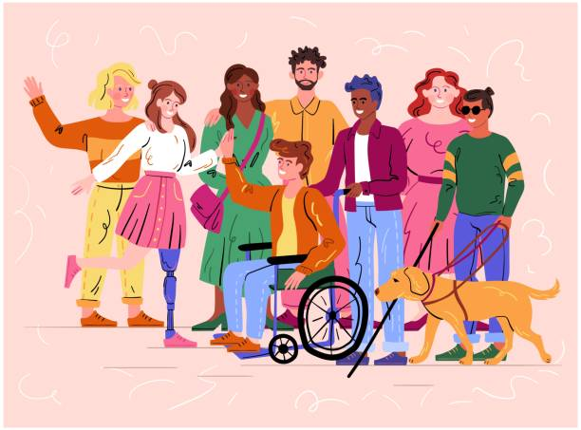
Closing Statement
Notes:
Reflecting on Ishaan’s statement from the beginning, our app will help people find accessible entrances and restrooms. This app also helps people collaborate by commenting on campus buildings. Our app will help users not feel forgotten.

Slide 21

Citations
[1] Admin. “U.S. Wheelchair User Statistics.” Pants Up Easy, 29 July 2017, https://www.pantsupeasy.com/u-s-wheelchair-user-statistics/
[2] “Study Finds Most Americans Have Good Vision, but 14 Million Are Visually Impaired.” National Institutes of Health, U.S. Department of Health and Human Services, 9 Dec. 2015, https://www.nih.gov/news-events/news-releases/study-finds-most-americans-have-good-vision-14-million-are-visually-impaired

Slide 22
References
“Desktop Browser Market Share Worldwide.” StatCounter Global Stats, https://gs.statcounter.com/browser-market-share/desktop/worldwide.
“Disability Resources and Services.” Office for Equity, Diversity, and Inclusion | University of Pittsburgh, 1 Aug. 2022, https://www.diversity.pitt.edu/disability-access/disability-resources-and-services.
Jagani, Sunil. “Mobile Website vs Wrapper Application – What to Use & When?” AllianceTek Inc, 7 Apr. 2020, https://www.alliancetek.com/blog/post/2014/09/08/mobile-website-or-wrapper-application-e28093-what-to-use-when.aspx.
“Managed Server Hosting.” Managed Server Hosting | Information Technology | University of Pittsburgh, 1 Aug. 2020, https://www.technology.pitt.edu/services/managed-server-hosting.
“Mobile Operating System Market Share Worldwide.” StatCounter Global Stats, https://gs.statcounter.com/os-market-share/mobile/worldwide.
“Pricing | Identity Platform | Google Cloud.” Google, Google, https://cloud.google.com/identity-platform/pricing.
“Service Level Agreement for Hosting and Realtime Database | Firebase.” Google, Google, https://firebase.google.com/terms/service-level-agreement.
“U.S. and World Population Clock.” United States Census Bureau, https://www.census.gov/popclock/.
“University of Pittsburgh-Pittsburgh Campus Student Population and Demographics.” Univstats, https://www.univstats.com/colleges/university-of-pittsburgh-pittsburgh-campus/student-population/.

